Slide 1
Vector Review

Slide 2
Coordinate Systems
Right handed coordinate system

Slide 3



Vector Arithmetic
$$a={\left[\begin{matrix}a_{x} & a_{y} & a_{z}\end{matrix}\right]}^{T}$$
$$b={\left[\begin{matrix}b_{x} & b_{y} & b_{z}\end{matrix}\right]}^{T}$$
$$a+b={\left[\begin{matrix}a_{x}+b_{x} & a_{y}+b_{y} & a_{z}+b_{z}\end{matrix}\right]}^{T}$$
$$a−b={\left[\begin{matrix}a_{x}−b_{x} & a_{y}−b_{y} & a_{z}−b_{z}\end{matrix}\right]}^{T}$$
s$a={\left[\begin{matrix}sa_{x} & sa_{y} & sa_{z}\end{matrix}\right]}^{T}$

Slide 4


Vector Magnitude
The magnitude (length) of a vector is:
A vector with length=1.0 is called a unit vector
We can also normalize a vector to make it a unit vector:
$$\left\|v\right\|=\sqrt{{v_{x}}^{2}+{v_{y}}^{2}+{v_{z}}^{2}}$$
$$\frac{v}{\left\|v\right\|}$$

Slide 5





Dot Product
$$a∙b=\sum_{i}{a_{i}b_{i}}$$
$a∙b=a_{x}b_{x}+a_{y}b_{y}$+$a_{z}b_{z}$
$$a∙b=\left\|a\right\|\left\|b\right\|\cos{θ}$$
$$a∙b=a^{T}b$$
$$a∙b=\left[\begin{matrix}a_{x} & a_{y} & a_{z}\end{matrix}\right]\left[\begin{matrix}b_{x} \\ b_{y} \\ b_{z}\end{matrix}\right]$$

Slide 6
Example: Angle Between Vectors
How do you find the angle θ between vectors a and b?
b
θ
a

Slide 7



Example: Angle Between Vectors
$$a∙b=\left\|a\right\|\left\|b\right\|\cos{θ}$$
$$\cos{θ}=\frac{a∙b}{\left\|a\right\|\left\|b\right\|}$$
$$θ=\cos^{−1}{\frac{a∙b}{\left\|a\right\|\left\|b\right\|}}$$
b
θ
a

Slide 8
Dot Products with General Vectors
The dot product is a scalar value that tells us something about the relationship between two vectors
If a^{T}b > 0 then θ < 90º
If a^{T}b < 0 then θ > 90º
If a^{T}b = 0 then θ = 90º (or one or more of the vectors is degenerate (0,0,0))

Slide 9
Dot Products with One Unit Vector
If ||u||=1.0 then a^{T}u is the length of the projection of a onto u
a
u
a^{T}u

Slide 10
Example: Distance to Plane
A plane is described by a point p on the plane and a unit normal n. Find the distance from point x to the plane
• x
n
p
•

Slide 11

Example: Distance to Plane
The distance is the length of the projection of x-p onto n:
$$dist={\left(x−p\right)}^{T}n$$
• x
n
x-p
p
•

Slide 12


Dot Products with Unit Vectors
0 < a^{T}b < 1
a^{T}b = 0
a^{T}b = 1
b
θ
a
-1 < a^{T}b < 0
a^{T}b
$$\left\|a\right\|=\left\|b\right\|=1$$
$$a∙b=\cos{θ}$$
a^{T}b = -1

Slide 13



Cross Product
$$a×b=\left|\begin{matrix}i & j & k \\ a_{x} & a_{y} & a_{z} \\ b_{x} & b_{y} & b_{z}\end{matrix}\right|$$
$=\left|\begin{matrix}a_{y} & a_{z} \\ b_{y} & b_{z}\end{matrix}\right|i−\left|\begin{matrix}a_{x} & a_{z} \\ b_{x} & b_{z}\end{matrix}\right|j$+$\left|\begin{matrix}a_{x} & a_{y} \\ b_{x} & b_{y}\end{matrix}\right|k$
$$a×b=\left[\begin{matrix}a_{y}b_{z}−a_{z}b_{y} \\ a_{z}b_{x}−a_{x}b_{z} \\ a_{x}b_{y}−a_{y}b_{x}\end{matrix}\right]$$

Slide 14



Cross Product Matrix
If v = [x, y, z]^{T} is a vector, the skew-symmetric matrix
is the cross product matrix of v
Cross-product as a matrix multiply:
Geometric interpretation of : (suppose v is of unit length)
Project a onto the plane normal to v
Rotate it by 90 degree about v
Resulting vector is perpendicular to both v and a
$${\left[v\right]}_{×}=\left[\begin{matrix}0 & −z & y \\ z & 0 & −x \\ −y & x & 0\end{matrix}\right]$$
$$v×a={\left[v\right]}_{×}a$$
$$v×a$$

Slide 15




Properties of the Cross Product
is a vector perpendicular to both a and b, in the direction defined by the right hand rule
$$a×b$$
$$\left\|a×b\right\|=\left\|a\right\|\left\|b\right\|\sin{θ}$$
$$\left\|a×b\right\|=$$
area of parallelogram ab
$$\left\|a×b\right\|=0$$
if a and b are parallel

Slide 16
Example: Normal of a Triangle
Find the unit length normal of the triangle defined by 3D points a, b, and c
c
b
a

Slide 17


Example: Normal of a Triangle
$$n′=\left(b−a\right)×\left(c−a\right)$$
$$n=\frac{n′}{\left\|n′\right\|}$$
c
c-a
b
a
b-a

Slide 18
Example: Area of a Triangle
Find the area of the triangle defined by 3D points a, b, and c
c
b
a

Slide 19

Example: Area of a Triangle
$$area=\frac{1}{2}\left\|\left(b−a\right)×\left(c−a\right)\right\|$$
c
c-a
b
a
b-a

Slide 20
Example: Alignment to Target
An object is at position p with a unit length heading of h. We want to rotate it so that the heading is facing some target t. Find a unit axis a and an angle θ to rotate around.
•
t
•
p
h

Slide 21


Example: Alignment to Target
$$a=\frac{h×\left(t−p\right)}{\left\|h×\left(t−p\right)\right\|}$$
$$θ=\cos^{−1}{\frac{h∙\left(t−p\right)}{\left\|t−p\right\|}}$$
a
t
t-p
•
p
θ
h

Slide 22
Matrix Review

Slide 23
3D Models
Let’s say we have a 3D model that has an array of position vectors describing its shape
We will group all of the position vectors used to store the data in the model into a single array: v_{n} where 0 ≤ n ≤ NumVerts-1
Each vector v_{n} has components v_{nx} , v_{ny} , v_{nz}

Slide 24
Translation
Let’s say that we want to move our 3D model from it’s current location to somewhere else…
In technical jargon, we call this a translation
We want to compute a new array of positions v’_{n} representing the new location
Let’s say that vector d represents the relative offset that we want to move our object by
We can simply use: v’_{n} = v_{n} + d
to get the new array of positions

Slide 25
Transformations
v’_{n} = v_{n} + d
This translation represents a very simple example of an object transformation
The result is that the entire object gets moved or translated by d
From now on, we will drop the _{n} subscript, and just write
v′ = v + d
remembering that in practice, this is actually a loop over several different v_{n} vectors applying the same vector d every time

Slide 26
Transformations
$$v′=v+d$$
Always remember that this compact equation can be expanded out into
$\left[\begin{matrix}{v′}_{x} \\ {v′}_{y} \\ {v′}_{z}\end{matrix}\right]=\left[\begin{matrix}v_{x} \\ v_{y} \\ v_{z}\end{matrix}\right]$+$\left[\begin{matrix}d_{x} \\ d_{y} \\ d_{z}\end{matrix}\right]$

Slide 27
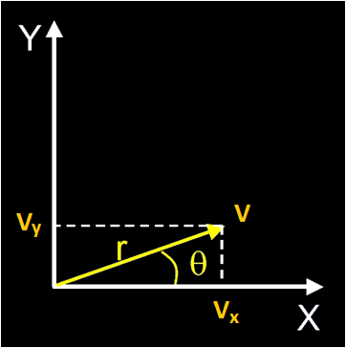
Rotation
Now, let’s rotate the object in the xy plane by an angle θ, as if we were spinning it around the z axis
Represent the object point v as:
$$v_{x}=r\cos{θ}$$
$$v_{y}=r\sin{θ}$$

Slide 28
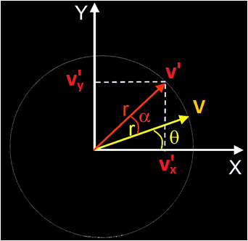
Rotation
Now, let’s rotate the object in the xy plane by an angle θ, as if we were spinning it around the z axis
Represent the object point v as:
Represent the rotated point v’ as:
$$v_{x}=r\cos{θ}$$
$$v_{y}=r\sin{θ}$$
$${v′}_{x}=r\cos\left(θ+α\right)$$
$${v′}_{y}=r\sin\left(θ+α\right)$$

Slide 29
Rotation
$${v′}_{x}=r\cos\left(θ+α\right)=r\left(\cos{θ}\cos{α}−\sin{θ}\sin{α}\right)$$
$${v′}_{y}=r\sin\left(θ+α\right)=r\left(\sin{θ}\cos{α}+\cos{θ}\sin{α}\right)$$
$${v′}_{x}=v_{x}\cos{α}−v_{y}\sin{α}$$
$${v′}_{y}=v_{x}\sin{α}+v_{y}\cos{α}$$
$$\left[\begin{matrix}{v′}_{x} \\ {v′}_{y} \\ {v′}_{z}\end{matrix}\right]=\left[\begin{matrix}\cos{α} & −\sin{α} & 0 \\ \sin{α} & \cos{α} & 0 \\ 0 & 0 & 1\end{matrix}\right]\left[\begin{matrix}v_{x} \\ v_{y} \\ v_{z}\end{matrix}\right]$$

Slide 30
Rotation
We can represent a z-axis rotation transformation in matrix form as:
or more compactly as:
where
$$\left[\begin{matrix}{v′}_{x} \\ {v′}_{y} \\ {v′}_{z}\end{matrix}\right]=\left[\begin{matrix}\cos{α} & −\sin{α} & 0 \\ \sin{α} & \cos{α} & 0 \\ 0 & 0 & 1\end{matrix}\right]\left[\begin{matrix}v_{x} \\ v_{y} \\ v_{z}\end{matrix}\right]$$
$$v^{′}=Mv$$
$$M=R_{z}\left(α\right)=\left[\begin{matrix}\cos{α} & −\sin{α} & 0 \\ \sin{α} & \cos{α} & 0 \\ 0 & 0 & 1\end{matrix}\right]$$

Slide 31
Rotation
We can also define rotation matrices for the x, y, and z axes:
$$R_{x}\left(α\right)=\left[\begin{matrix}1 & 0 & 0 \\ 0 & \cos{α} & −\sin{α} \\ 0 & \sin{α} & \cos{α}\end{matrix}\right]$$
$$R_{y}\left(α\right)=\left[\begin{matrix}\cos{α} & 0 & \sin{α} \\ 0 & 1 & 0 \\ −\sin{α} & 0 & \cos{α}\end{matrix}\right]$$
$$R_{z}\left(α\right)=\left[\begin{matrix}\cos{α} & −\sin{α} & 0 \\ \sin{α} & \cos{α} & 0 \\ 0 & 0 & 1\end{matrix}\right]$$

Slide 32
Affine Transformations
Like translation, rotation is an example of a affine transformation
Affine Transformation: Linear Transformation + Translation
True, the rotation contains sin()’s and cos()’s, but those ultimately just end up as constants in the actual linear equation
We can generalize our matrix in the previous example to be:
$$M=\left[\begin{matrix}a_{1} & b_{1} & c_{1} \\ a_{2} & b_{2} & c_{2} \\ a_{3} & b_{3} & c_{3}\end{matrix}\right]$$
$$v^{′}=Mv$$

Slide 33
Affine Equation
A general affine equation of 1 variable is:
where a and d are constants
A general affine equation of 3 variables is:
Note: there are no nonlinear terms like v_{x}v_{y}, v_{x}², sin(v_{x})…
$$f\left(v\right)=av+d$$
$$f\left(v_{x},v_{y},v_{z}\right)=f\left(v\right)=av_{x}+bv_{y}+cv_{z}+d$$

Slide 34
System of Affine Equations
Now let’s look at 3 affine equations of 3 variables v_{x}, v_{y}, and v_{z}
Note that all of the a_{n}, b_{n}, c_{n}, and d_{n} are constants (12 in total)
$${v′}_{x}=a_{1}v_{x}+b_{1}v_{y}+c_{1}v_{z}+d_{1}$$
$${v′}_{y}=a_{2}v_{x}+b_{2}v_{y}+c_{2}v_{z}+d_{2}$$
$${v′}_{z}=a_{3}v_{x}+b_{3}v_{y}+c_{3}v_{z}+d_{3}$$

Slide 35
Matrix Notation
$${v′}_{x}=a_{1}v_{x}+b_{1}v_{y}+c_{1}v_{z}+d_{1}$$
$${v′}_{y}=a_{2}v_{x}+b_{2}v_{y}+c_{2}v_{z}+d_{2}$$
$${v′}_{z}=a_{3}v_{x}+b_{3}v_{y}+c_{3}v_{z}+d_{3}$$
$$\left[\begin{matrix}{v′}_{x} \\ {v′}_{y} \\ {v′}_{z}\end{matrix}\right]=\left[\begin{matrix}a_{1} & b_{1} & c_{1} \\ a_{2} & b_{2} & c_{2} \\ a_{3} & b_{3} & c_{3}\end{matrix}\right]\left[\begin{matrix}v_{x} \\ v_{y} \\ v_{z}\end{matrix}\right]+\left[\begin{matrix}d_{1} \\ d_{2} \\ d_{3}\end{matrix}\right]$$
$$v^{′}=Mv+d$$

Slide 36
Translation
Let’s look at our translation transformation again:
If we really wanted to, we could rewrite our three translation equations as:
$${v′}_{x}=v_{x}+d_{x}$$
$$v^{′}=v+d$$
$${v′}_{y}=v_{y}+d_{y}$$
$${v′}_{z}=v_{z}+d_{z}$$
$${v′}_{x}=1v_{x}+0v_{y}+0v_{z}+d_{x}$$
$${v′}_{y}=0v_{x}+1v_{y}+0v_{z}+d_{y}$$
$${v′}_{z}=0v_{x}+0v_{y}+1v_{z}+d_{z}$$

Slide 37
Identity
We can see that this is equal to a transformation by the identity matrix
$${v′}_{x}=1v_{x}+0v_{y}+0v_{z}+d_{x}$$
$${v′}_{y}=0v_{x}+1v_{y}+0v_{z}+d_{y}$$
$${v′}_{z}=0v_{x}+0v_{y}+1v_{z}+d_{z}$$
$$\left[\begin{matrix}{v′}_{x} \\ {v′}_{y} \\ {v′}_{z}\end{matrix}\right]=\left[\begin{matrix}1 & 0 & 0 \\ 0 & 1 & 0 \\ 0 & 0 & 1\end{matrix}\right]\left[\begin{matrix}v_{x} \\ v_{y} \\ v_{z}\end{matrix}\right]+\left[\begin{matrix}d_{x} \\ d_{y} \\ d_{z}\end{matrix}\right]$$

Slide 38
Identity
Multiplication by the identity matrix does not affect the vector
$$I=\left[\begin{matrix}1 & 0 & 0 \\ 0 & 1 & 0 \\ 0 & 0 & 1\end{matrix}\right]$$
$$v=I v$$

Slide 39
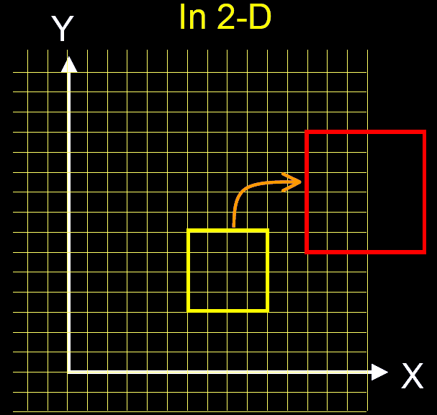
Uniform Scaling
We can apply a uniform scale to our object with the following transformation
$$\left[\begin{matrix}{v′}_{x} \\ {v′}_{y} \\ {v′}_{z}\end{matrix}\right]=\left[\begin{matrix}s & 0 & 0 \\ 0 & s & 0 \\ 0 & 0 & s\end{matrix}\right]\left[\begin{matrix}v_{x} \\ v_{y} \\ v_{z}\end{matrix}\right]$$

Slide 40
Uniform Scaling
If s>1, then the object will grow by a factor of s in each dimension
If 0<s<1, the object will shrink
If s<0, the object will be reflected across all three dimensions, leading to an object that is ‘inside out’
$$\left[\begin{matrix}{v′}_{x} \\ {v′}_{y} \\ {v′}_{z}\end{matrix}\right]=\left[\begin{matrix}s & 0 & 0 \\ 0 & s & 0 \\ 0 & 0 & s\end{matrix}\right]\left[\begin{matrix}v_{x} \\ v_{y} \\ v_{z}\end{matrix}\right]$$

Slide 41
Non-Uniform Scaling
We can also do a more general nonuniform scale, where each dimension has its own scale factor
which leads to the equations:
$$\left[\begin{matrix}{v′}_{x} \\ {v′}_{y} \\ {v′}_{z}\end{matrix}\right]=\left[\begin{matrix}s_{x} & 0 & 0 \\ 0 & s_{y} & 0 \\ 0 & 0 & s_{z}\end{matrix}\right]\left[\begin{matrix}v_{x} \\ v_{y} \\ v_{z}\end{matrix}\right]$$
$${v′}_{x}=s_{x}v_{x}$$
$${v′}_{y}=s_{y}v_{y}$$
$${v′}_{z}=s_{z}v_{z}$$

Slide 42
Multiple Transformations
If we have a vector v, and an x-axis rotation matrix R_{x}, we can generate a rotated vector v′:
If we wanted to then rotate that vector around the y-axis, we could simply:
$$v^{′}=R_{x}\left(α\right)v$$
$$v^{′′}=R_{y}\left(β\right)v′$$
$$v^{′′}=R_{y}\left(β\right)\left(R_{x}\left(α\right)v\right)$$

Slide 43
Multiple Transformations
We can extend this to the concept of applying any sequence of transformations:
Because matrix algebra obeys the associative law, we can regroup this as:
This allows us to concatenate them into a single matrix:
Note: matrices do NOT obey the commutative law, so the order of multiplications is important
$$v^{′}=M_{4}\left(M_{3}\left(M_{2}\left(M_{1}v\right)\right)\right)$$
$$v^{′}=\left(M_{4}M_{3}M_{2}M_{1}\right)v$$
$$M_{total}=M_{4}M_{3}M_{2}M_{1}$$
$$v^{′}=M_{total}v$$

Slide 44
Matrix times Matrix
$$L=M∙N$$
$$\left[\begin{matrix}l_{11} & l_{12} & l_{13} \\ l_{21} & l_{22} & l_{23} \\ l_{31} & l_{32} & l_{33}\end{matrix}\right]=\left[\begin{matrix}m_{11} & m_{12} & m_{13} \\ m_{21} & m_{22} & m_{23} \\ m_{31} & m_{32} & m_{33}\end{matrix}\right]\left[\begin{matrix}n_{11} & n_{12} & n_{13} \\ n_{21} & n_{22} & n_{23} \\ n_{31} & n_{32} & n_{33}\end{matrix}\right]$$
$$l_{12}=m_{11}n_{12}+m_{12}n_{22}+m_{13}n_{32}$$

Slide 45
Multiple Rotations & Scales
We can combine a sequence of rotations and scales into a single matrix
For example, we can combine a y-rotation, followed by a z-rotation, then a non-uniform scale, and finally an x-rotation:
$$M=R_{x}\left(γ\right)S\left(s\right)R_{z}\left(β\right)R_{y}\left(α\right)$$
$$v^{′}=Mv$$

Slide 46
Multiple Translations
We can also take advantage of the associative property of vector addition to combine a sequence of translations
For example, a translation along vector t₁ followed by a translation along t₂ and finally t₃ can be combined:
$$d=t_{1}+t_{2}+t_{3}$$
$$v^{′}=v+d$$

Slide 47
Combining Transformations
We see that we can combine a sequence of rotations and/or scales
We can also combine a sequence of translations
But what if we want to combine translations with rotations/scales?

Slide 48
Homogeneous Transformations
$$v′=Mv$$
$$\left[\begin{matrix}\begin{matrix}{v′}_{x} \\ {v′}_{y}\end{matrix} \\ \begin{matrix}{v′}_{z} \\ 1\end{matrix}\end{matrix}\right]=\left[\begin{matrix}\begin{matrix}a_{1} & b_{1} \\ a_{2} & b_{2}\end{matrix} & \begin{matrix}c_{1} & d_{1} \\ c_{2} & d_{2}\end{matrix} \\ \begin{matrix}a_{3} & b_{3} \\ 0 & 0\end{matrix} & \begin{matrix}c_{3} & d_{3} \\ 0 & 1\end{matrix}\end{matrix}\right]\left[\begin{matrix}\begin{matrix}v_{x} \\ v_{y}\end{matrix} \\ \begin{matrix}v_{z} \\ 1\end{matrix}\end{matrix}\right]$$
$${v′}_{x}=a_{1}v_{x}+b_{1}v_{y}+c_{1}v_{z}+d_{1}$$
$${v′}_{y}=a_{2}v_{x}+b_{2}v_{y}+c_{2}v_{z}+d_{2}$$
$${v′}_{z}=a_{3}v_{x}+b_{3}v_{y}+c_{3}v_{z}+d_{3}$$
$$1=0v_{x}+0v_{y}+0v_{z}+1$$

Slide 49
Homogeneous Transformations
So we’ve basically taken the 3x3 rotation/scale matrix and the 3x1 translation vector from our original equation and combined them into a new 4x4 matrix (for today, we will always have [0 0 0 1] in the last row of the matrix)
We also replace our 3D position vector v with its 4D version [v_{x} v_{y} v_{z} 1]^{T}
Using 4x4 transformation matrices allows us to combine rotations, translations, scales, shears, and reflections into a single matrix
For rendering, we use the last row as well to perform perspective projections, but for animation, we are mainly concerned with placing objects in 3D space, not rendering them into a 2D image, so we will almost always have [0 0 0 1] on the last row.

Slide 50
Homogeneous Transformations
For example, a translation by vector r followed by a z-axis rotation can be represented as:
$$\left[\begin{matrix}\begin{matrix}{v′}_{x} \\ {v′}_{y}\end{matrix} \\ \begin{matrix}{v′}_{z} \\ 1\end{matrix}\end{matrix}\right]=\left[\begin{matrix}\begin{matrix}\cos{θ} & −\sin{θ} \\ \sin{θ} & \cos{θ}\end{matrix} & \begin{matrix}0 & 0 \\ 0 & 0\end{matrix} \\ \begin{matrix}0 & 0 \\ 0 & 0\end{matrix} & \begin{matrix}1 & 0 \\ 0 & 1\end{matrix}\end{matrix}\right]\left[\begin{matrix}\begin{matrix}1 & 0 \\ 0 & 1\end{matrix} & \begin{matrix}0 & r_{x} \\ 0 & r_{y}\end{matrix} \\ \begin{matrix}0 & 0 \\ 0 & 0\end{matrix} & \begin{matrix}1 & r_{z} \\ 0 & 1\end{matrix}\end{matrix}\right]\left[\begin{matrix}\begin{matrix}v_{x} \\ v_{y}\end{matrix} \\ \begin{matrix}v_{z} \\ 1\end{matrix}\end{matrix}\right]$$

Slide 51
Homogeneous Vectors
$$\left[\begin{matrix}\frac{v_{x}}{v_{w}} \\ \frac{v_{y}}{v_{w}} \\ \frac{v_{z}}{v_{w}}\end{matrix}\right]$$
$$\left[\begin{matrix}\begin{matrix}v_{x} \\ v_{y}\end{matrix} \\ \begin{matrix}v_{z} \\ v_{w}\end{matrix}\end{matrix}\right]$$
Technically, homogeneous vectors are 4D vectors that get projected into the 3D w=1 space
Notes:
51

Slide 52
Homogeneous Vectors
$$\left[\begin{matrix}\begin{matrix}v_{x} & v_{y}\end{matrix} & \begin{matrix}v_{z} & 1\end{matrix}\end{matrix}\right]$$
$$\left[\begin{matrix}\begin{matrix}v_{x} & v_{y}\end{matrix} & \begin{matrix}v_{z} & 0\end{matrix}\end{matrix}\right]$$
Vectors representing a position in 3D space can just be written as:
Vectors representing direction are written:
The only time the w coordinate will be something other than 0 or 1 is in the projection phase of rendering, which is not our problem
Notes:
52

Slide 53
Matrix times Position Vector
$$v={\left[\begin{matrix}\begin{matrix}v_{x} & v_{y}\end{matrix} & \begin{matrix}v_{z} & 1\end{matrix}\end{matrix}\right]}^{T}$$
$$M=\left[\begin{matrix}\begin{matrix}a_{x} & b_{x} \\ a_{y} & b_{y}\end{matrix} & \begin{matrix}c_{x} & d_{x} \\ c_{y} & d_{y}\end{matrix} \\ \begin{matrix}a_{z} & b_{z} \\ 0 & 0\end{matrix} & \begin{matrix}c_{z} & d_{z} \\ 0 & 1\end{matrix}\end{matrix}\right]$$
$$v′=Mv$$
$${v′}_{x}=a_{x}v_{x}+b_{x}v_{y}+c_{x}v_{z}+d_{x}$$
$${v′}_{y}=a_{y}v_{x}+b_{y}v_{y}+c_{y}v_{z}+d_{y}$$
$$v^{′}=av_{x}+bv_{y}+cv_{z}+d$$
$${v′}_{z}=a_{z}v_{x}+b_{z}v_{y}+c_{z}v_{z}+d_{z}$$
$${v′}_{w}=0v_{x}+0v_{y}+0v_{z}+1$$
Notes:
53

Slide 54
Matrix times Position Vector
$$v^{′}=av_{x}+bv_{y}+cv_{z}+d$$
y
v=(.5,.5,0,1)
x
(0,0,0)
Local Space
Notes:
54

Slide 55
Matrix Dot Position Vector
b
$$v^{′}=av_{x}+bv_{y}+cv_{z}+d$$
Matrix M
y
y
d
a
v=(.5,.5,0,1)
x
x
(0,0,0)
(0,0,0)
Local Space
World Space
Notes:
55

Slide 56
Matrix Dot Position Vector
b
$$v^{′}=av_{x}+bv_{y}+cv_{z}+d$$
v’
y
y
d
a
v=(.5,.5,0,1)
x
x
(0,0,0)
(0,0,0)
Local Space
World Space
Notes:
56

Slide 57
Matrix times Direction Vector
$$v={\left[\begin{matrix}\begin{matrix}v_{x} & v_{y}\end{matrix} & \begin{matrix}v_{z} & 0\end{matrix}\end{matrix}\right]}^{T}$$
$$M=\left[\begin{matrix}\begin{matrix}a_{x} & b_{x} \\ a_{y} & b_{y}\end{matrix} & \begin{matrix}c_{x} & d_{x} \\ c_{y} & d_{y}\end{matrix} \\ \begin{matrix}a_{z} & b_{z} \\ 0 & 0\end{matrix} & \begin{matrix}c_{z} & d_{z} \\ 0 & 1\end{matrix}\end{matrix}\right]$$
$$v′=Mv$$
$${v′}_{x}=a_{x}v_{x}+b_{x}v_{y}+c_{x}v_{z}$$
$${v′}_{y}=a_{y}v_{x}+b_{y}v_{y}+c_{y}v_{z}$$
$$v^{′}=av_{x}+bv_{y}+cv_{z}$$
$${v′}_{z}=a_{z}v_{x}+b_{z}v_{y}+c_{z}v_{z}$$
$${v′}_{w}=0v_{x}+0v_{y}+0v_{z}$$
Notes:
57

Slide 58
Matrix times Matrix (4x4)
$$M=\left[\begin{matrix}\begin{matrix}a_{x} & b_{x} \\ a_{y} & b_{y}\end{matrix} & \begin{matrix}c_{x} & d_{x} \\ c_{y} & d_{y}\end{matrix} \\ \begin{matrix}a_{z} & b_{z} \\ 0 & 0\end{matrix} & \begin{matrix}c_{z} & d_{z} \\ 0 & 1\end{matrix}\end{matrix}\right]$$
$$M′=N∙M$$
The column vectors of M’ are the column vectors of M transformed by matrix N
Notice that a, b, and c transform as direction vectors and d transforms as a position
Notes:
58

Slide 59
Rotation Matrices
$$R_{x}\left(θ\right)=\left[\begin{matrix}\begin{matrix}\begin{matrix}\begin{matrix}1 \\ 0\end{matrix} \\ \begin{matrix}0 \\ 0\end{matrix}\end{matrix} & \begin{matrix}\begin{matrix}0 \\ \cos{θ}\end{matrix} \\ \begin{matrix}\sin{θ} \\ 0\end{matrix}\end{matrix}\end{matrix} & \begin{matrix}\begin{matrix}\begin{matrix}0 \\ −\sin{θ}\end{matrix} \\ \begin{matrix}\cos{θ} \\ 0\end{matrix}\end{matrix} & \begin{matrix}\begin{matrix}0 \\ 0\end{matrix} \\ \begin{matrix}0 \\ 1\end{matrix}\end{matrix}\end{matrix}\end{matrix}\right]$$
$$R_{y}\left(θ\right)=\left[\begin{matrix}\begin{matrix}\begin{matrix}\begin{matrix}\cos{θ} \\ 0\end{matrix} \\ \begin{matrix}−\sin{θ} \\ 0\end{matrix}\end{matrix} & \begin{matrix}\begin{matrix}0 \\ 1\end{matrix} \\ \begin{matrix}0 \\ 0\end{matrix}\end{matrix}\end{matrix} & \begin{matrix}\begin{matrix}\begin{matrix}\sin{θ} \\ 0\end{matrix} \\ \begin{matrix}\cos{θ} \\ 0\end{matrix}\end{matrix} & \begin{matrix}\begin{matrix}0 \\ 0\end{matrix} \\ \begin{matrix}0 \\ 1\end{matrix}\end{matrix}\end{matrix}\end{matrix}\right]$$
$$R_{z}\left(θ\right)=\left[\begin{matrix}\begin{matrix}\begin{matrix}\begin{matrix}\cos{θ} \\ \sin{θ}\end{matrix} \\ \begin{matrix}0 \\ 0\end{matrix}\end{matrix} & \begin{matrix}\begin{matrix}−\sin{θ} \\ \cos{θ}\end{matrix} \\ \begin{matrix}0 \\ 0\end{matrix}\end{matrix}\end{matrix} & \begin{matrix}\begin{matrix}\begin{matrix}0 \\ 0\end{matrix} \\ \begin{matrix}1 \\ 0\end{matrix}\end{matrix} & \begin{matrix}\begin{matrix}0 \\ 0\end{matrix} \\ \begin{matrix}0 \\ 1\end{matrix}\end{matrix}\end{matrix}\end{matrix}\right]$$

Slide 60
Translations
A 4x4 translation matrix that translates an object by the vector r is:
$$T\left(r\right)=\left[\begin{matrix}\begin{matrix}\begin{matrix}\begin{matrix}1 \\ 0\end{matrix} \\ \begin{matrix}0 \\ 0\end{matrix}\end{matrix} & \begin{matrix}\begin{matrix}0 \\ 1\end{matrix} \\ \begin{matrix}0 \\ 0\end{matrix}\end{matrix}\end{matrix} & \begin{matrix}\begin{matrix}\begin{matrix}0 \\ 0\end{matrix} \\ \begin{matrix}1 \\ 0\end{matrix}\end{matrix} & \begin{matrix}\begin{matrix}r_{x} \\ r_{y}\end{matrix} \\ \begin{matrix}r_{z} \\ 1\end{matrix}\end{matrix}\end{matrix}\end{matrix}\right]$$

Slide 61
Pivot Points
The standard rotation matrices pivot the object about an axis through the origin
What if we want the pivot point to be somewhere else?
The following transformation performs a z-axis rotation pivoted around the point r
$$M=T\left(r\right)R_{z}\left(θ\right)T\left(−r\right)$$

Slide 62
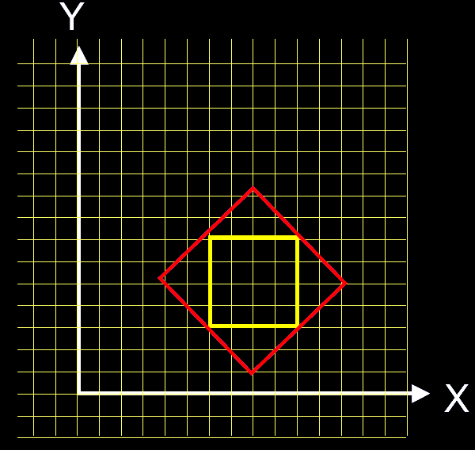
Composite Transformation
Example: rotate the square by 45 degrees around its center and scale by 1.5

Slide 63
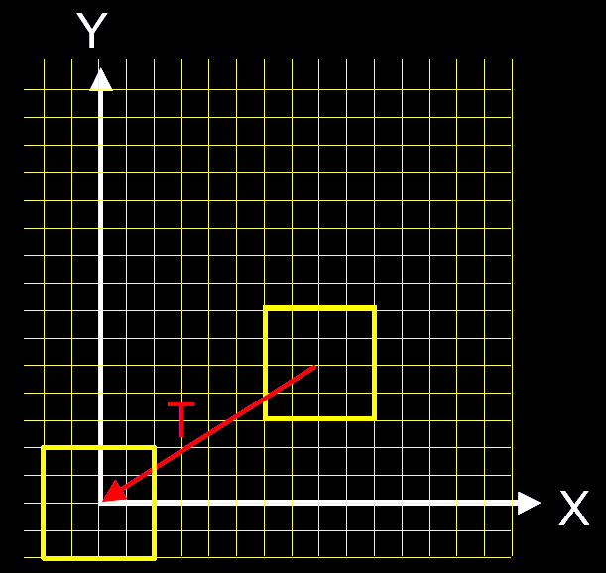
Composite Transformation
Step 1: Translate the center of the square to the origin (T)

Slide 64
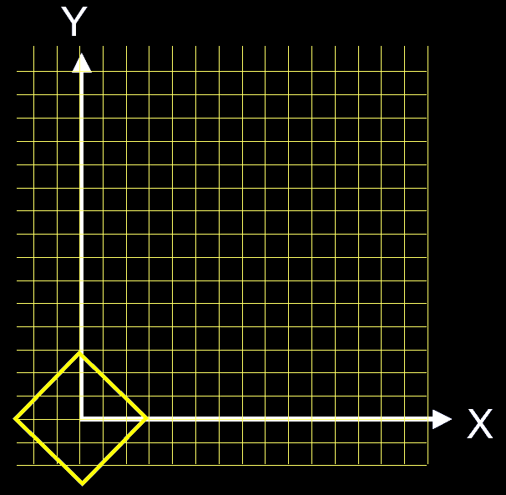
Composite Transformation
Step 2: rotate (R) (or scale (S))

Slide 65
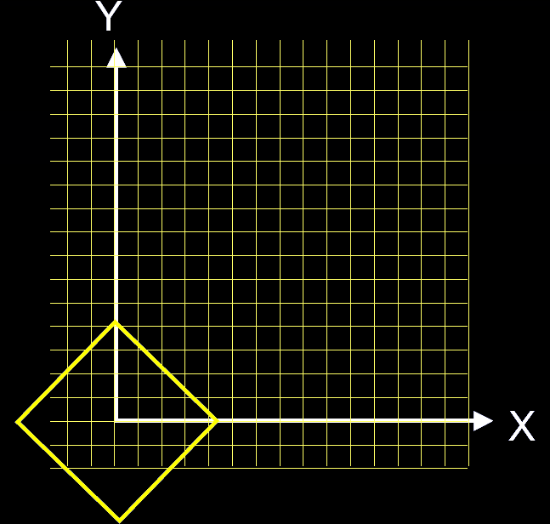
Composite Transformation
Step 3: scale (S) (or rotate (R))

Slide 66
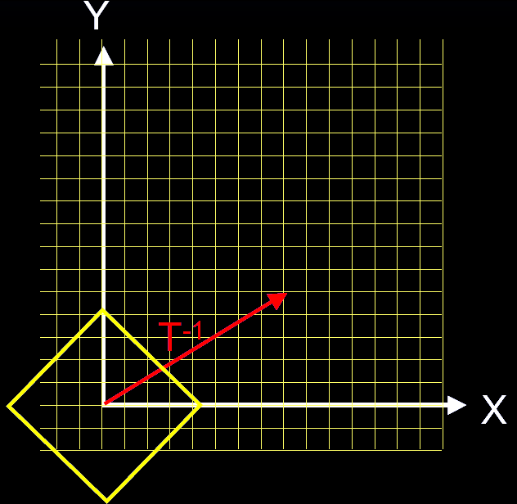
Composite Transformation
Step 4: translate back (T⁻¹)

Slide 67
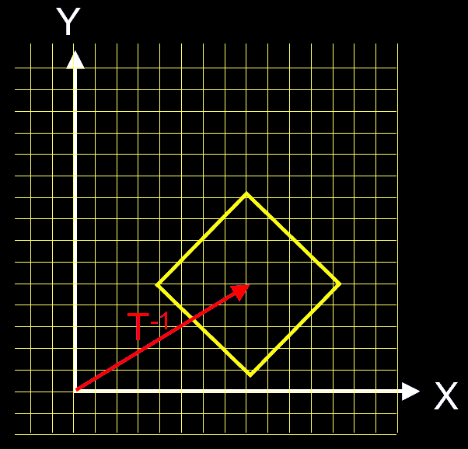
Composite Transformation
Composite: T⁻¹SRT or T⁻¹RST

Slide 68
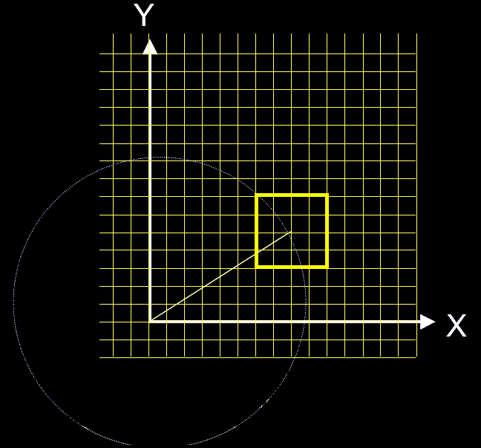
Composite Transformation
Without translating to the origin: SR

Slide 69
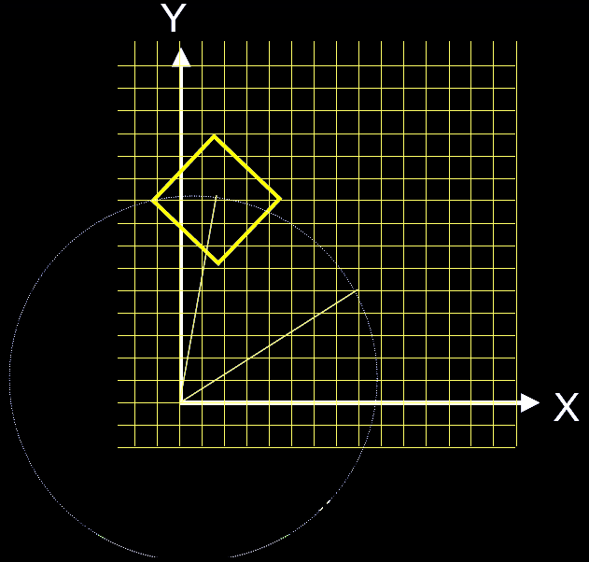
Composite Transformation
Without translating to the origin: SR (after the rotation)

Slide 70
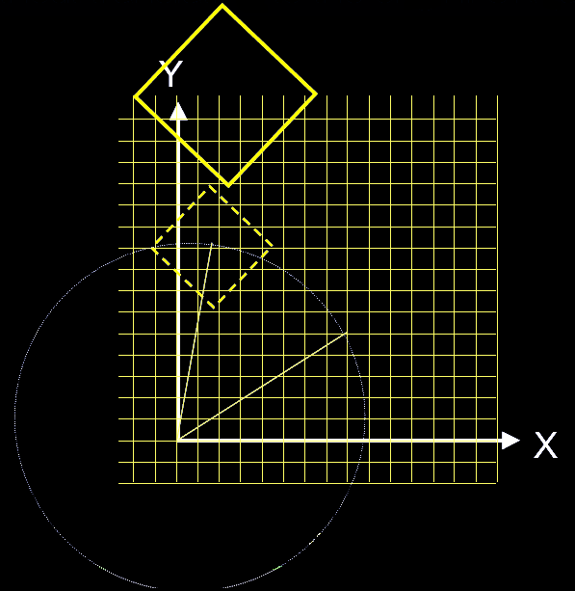
Composite Transformation
Without translating to the origin: SR (after the scaling)
Wrong Result!

Slide 71
Affine Transformations
All of the transformations we’ve seen so far are examples of affine transformations
If we have a pair of parallel lines and transform them with an affine transformation, they will remain parallel
Affine transformations are fast to compute and very useful throughout computer graphics

Slide 72
General 4x4 Matrix
All of the matrices we’ve seen so far have [0 0 0 1] in the last row
The product formed by multiplying any two matrices of this form will also have [0 0 0 1] in the last row
We can say that this set of matrices forms a multiplicative group of 3D affine transformations
We can construct any matrix in this group by multiplying a sequence of basic rotations, translations, scales, and shears
$$\left[\begin{matrix}\begin{matrix}a_{x} & b_{x} \\ a_{y} & b_{y}\end{matrix} & \begin{matrix}c_{x} & d_{x} \\ c_{y} & d_{y}\end{matrix} \\ \begin{matrix}a_{z} & b_{z} \\ 0 & 0\end{matrix} & \begin{matrix}c_{z} & d_{z} \\ 0 & 1\end{matrix}\end{matrix}\right]$$

Slide 73
General 4x4 Matrix
Assuming we have [0 0 0 1] in the last row, we see that there are 12 different numbers in the upper 3x4 portion of the 4x4 matrix
There are also 12 degrees of freedom for an object undergoing a affine transformation in 3D space
3 of those are represented by the three translational axes
3 of them are for rotation in the 3 planes (xy, yz, xz)
3 of them are scales along the 3 main axes
and the last 3 are shears in the 3 main planes (xy, yz, xz)
The 3 numbers for translation are easily decoded (d_{x}, d_{y}, d_{z})
The other 9 numbers, however, are encoded into the 9 numbers in the upper 3x3 portion of the matrix

Slide 74
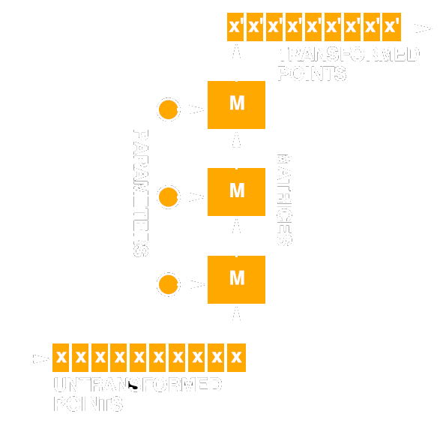
Sequences of Transformations
Often the same transformations are applied to many points
Calculation time for the matrices and combination is negligible compared to that of transforming the points
Reduce the sequence to a single matrix, then transform

Slide 75
Object Space
The space that an object is defined in is called object space or local space
Usually, the object is located at or near the origin and is aligned with the xyz axes in some reasonable way
The units in this space can be whatever we choose (i.e., meters, etc.)
A 3D object would be stored on disk and in memory in this coordinate system
When we go to draw the object, we will want to transform it into a different space

Slide 76
World Space
We will define a new space called world space
This space represents a 3D world or scene and may contain several objects placed in various locations
Every object in the world needs a matrix that transforms its vertices from its own object space into this world space
We will call this the object’s world matrix, or often, we will just call it the object’s matrix
For example, if we have 100 chairs in the room, we only need to store the object space data for the chair once, and we can use 100 different matrices to transform the chair model into 100 locations in the world

Slide 77
Rigid Matrices
$$M=\left[\begin{matrix}\begin{matrix}a_{x} & b_{x} \\ a_{y} & b_{y}\end{matrix} & \begin{matrix}c_{x} & d_{x} \\ c_{y} & d_{y}\end{matrix} \\ \begin{matrix}a_{z} & b_{z} \\ 0 & 0\end{matrix} & \begin{matrix}c_{z} & d_{z} \\ 0 & 1\end{matrix}\end{matrix}\right]$$
Computer graphics apps commonly use 4x4 homogeneous matrices
A rigid 4x4 matrix transformation looks like this:
Where a, b, & c are orthogonal unit length vectors representing orientation, and d is a vector representing position
Notes:
77

Slide 78
abcd Vectors
We mentioned that the translation information is easily extracted directly from the matrix, while the rotation information is encoded into the upper 3x3 portion of the matrix
Is there a geometric way to understand these 9 numbers?
In fact there is! The 9 constants make up 3 vectors called a, b, and c. If we think of the matrix as a transformation from object space to world space, then the a vector is essentially the object’s x-axis rotated into world space, b is its y-axis in world space, and c is its z-axis in world space. d is of course the origin position in world space.

Slide 79
Rigid Matrices
If the a, b, and c vectors are all unit length and perpendicular to each other, we say that the upper 3x3 matrix is orthonormal
If the upper 3x3 portion is orthonormal, we say that the 4x4 matrix is rigid, meaning that it describes an object that is only translated and rotated (in other words, it will not have any scale or shears which distort the object)

Slide 80
Rigid Matrices
If a 4x4 matrix represents a rigid transformation, then the upper 3x3 portion will be orthonormal
$$\left\|a\right\|=\left\|b\right\|=\left\|c\right\|=1$$
$$a=b×c$$
$$b=c×a$$
$$c=a×b$$

Slide 81
Matrix times Position Vector
$$v={\left[\begin{matrix}\begin{matrix}v_{x} & v_{y}\end{matrix} & \begin{matrix}v_{z} & 1\end{matrix}\end{matrix}\right]}^{T}$$
$$M=\left[\begin{matrix}\begin{matrix}a_{x} & b_{x} \\ a_{y} & b_{y}\end{matrix} & \begin{matrix}c_{x} & d_{x} \\ c_{y} & d_{y}\end{matrix} \\ \begin{matrix}a_{z} & b_{z} \\ 0 & 0\end{matrix} & \begin{matrix}c_{z} & d_{z} \\ 0 & 1\end{matrix}\end{matrix}\right]$$
$$v′=Mv$$
$${v′}_{x}=a_{x}v_{x}+b_{x}v_{y}+c_{x}v_{z}+d_{x}$$
$${v′}_{y}=a_{y}v_{x}+b_{y}v_{y}+c_{y}v_{z}+d_{y}$$
$$v^{′}=av_{x}+bv_{y}+cv_{z}+d$$
$${v′}_{z}=a_{z}v_{x}+b_{z}v_{y}+c_{z}v_{z}+d_{z}$$
$${v′}_{w}=0v_{x}+0v_{y}+0v_{z}+1$$
Notes:
81

Slide 82
Matrix times Position Vector
$$v^{′}=av_{x}+bv_{y}+cv_{z}+d$$
y
v=(.5,.5,0,1)
x
(0,0,0)
Local Space
Notes:
82

Slide 83
Matrix Dot Position Vector
b
$$v^{′}=av_{x}+bv_{y}+cv_{z}+d$$
Matrix M
y
y
d
a
v=(.5,.5,0,1)
x
x
(0,0,0)
(0,0,0)
Local Space
World Space
Notes:
83

Slide 84
Matrix Dot Position Vector
b
$$v^{′}=av_{x}+bv_{y}+cv_{z}+d$$
v’
y
y
d
a
v=(.5,.5,0,1)
x
x
(0,0,0)
(0,0,0)
Local Space
World Space
Notes:
84

Slide 85
Camera Matrix
Think of the camera just like any other object. Just as a chair model has a matrix W that transforms it into world space, the camera matrix C would transform a camera model into world space.
We don’t want to transform the camera into world space. Instead, we want to transform the world into the camera’s space, so we use the inverse of C.
Notes:
85

Slide 86
Example: Camera ‘Look At’
Our eye is located at position e and we want to look at a target at position t. Generate an appropriate camera matrix M.
Notes:
86

Slide 87
Example: Camera ‘Look At’
Our eye is located at position e and we want to look at a target at position t. Generate an appropriate camera matrix M.
Two possible approaches include:
Measure angles and rotate matrix into place
Construct a,b,c, & d vectors of M directly
Notes:
87

Slide 88
Example: Camera ‘Look At’ Method 1: Measure Angles & Rotate
Measure Angles:
Tilt angle
Heading angle
Position
Construct matrix by starting with the identity, then apply tilt and heading rotations
Notes:
88

Slide 89
Example: Camera ‘Look At’ Method 2: Build Matrix Directly
$$d=e$$
$$c=\frac{e−t}{\left\|e−t\right\|}$$
The d vector is just the position of the camera, which is e:
The c vector is a unit length vector that points directly behind the viewer:
Notes:
89

Slide 90
Example: Camera ‘Look At’ Method 2: Build Matrix Directly
$$a=\frac{y×c}{\left\|y×c\right\|}$$
$$\left[\begin{matrix}0 & 1 & 0\end{matrix}\right]×c=\left[\begin{matrix}c_{z} & 0 & c_{x}\end{matrix}\right]$$
The a vector is a unit length vector that points to the right of the viewer. It is perpendicular to the c axis. To keep the camera from rolling, we also want the a vector to lay flat in the xz-plane, perpendicular to the y-axis.
Note that a cross product with the y-axis can be optimized as follows:
Notes:
90

Slide 91
Example: Camera ‘Look At’ Method 2: Build Matrix Directly
$$b=c×a$$
$$\left\|b\right\|=\left\|c\right\|\left\|a\right\|\sin{{90}^{°}}=1∗1∗1$$
The b vector is a unit length vector that points up relative to the viewer. It is perpendicular to the both the c and a axes
Note that b does not need to be normalized because it is already unit length. This is because a and c are unit length vectors 90 degrees apart.
Notes:
91

Slide 92
Example: Camera ‘Look At’ Method 2: Build Matrix Directly
$$d=e$$
$$c=\frac{e−t}{\left\|e−t\right\|}$$
$$a=\frac{y×c}{\left\|y×c\right\|}$$
$$b=c×a$$
Summary:
Notes:
92

Slide 93
Determinants
$$\left|\begin{matrix}\begin{matrix}a_{x} & b_{x} \\ a_{y} & b_{y}\end{matrix} & \begin{matrix}c_{x} & d_{x} \\ c_{y} & d_{y}\end{matrix} \\ \begin{matrix}a_{z} & b_{z} \\ 0 & 0\end{matrix} & \begin{matrix}c_{z} & d_{z} \\ 0 & 1\end{matrix}\end{matrix}\right|=\left|\begin{matrix}a_{x} & b_{x} & c_{x} \\ a_{y} & b_{y} & c_{y} \\ a_{z} & b_{z} & c_{z}\end{matrix}\right|=a∙\left(b×c\right)$$
The determinant of a 4x4 matrix with no projection is equal to the determinant of the upper 3x3 portion
Notes:
93

Slide 94
Determinants
The determinant is a scalar value that represents the ratio of volume change that the transformation will cause
An orthonormal matrix will have a determinant of 1, but non-orthonormal volume preserving matrices will have a determinant of 1 also
A flattened or degenerate matrix has a determinant of 0
A matrix that has been mirrored will have a negative determinant
Notes:
94

Slide 95
Reading List
Computer Animation: Appendix B
B.5 Interpolating and approximating curves
Computer Animation: Chapter 3 Interpolating Values

